Slide 1
The 8237 DMA Controller

Slide 2
Basic Idea behind DMA Technique
Direct Memory Access (DMA) is a technique that allows the
direct data transfer between memory and I/O devices
keeping the microprocessor temporary disabled.
Two control signals are used to request and acknowledge
DMA transfer.
HOLD pin is an input that is used to request a DMA action.
HLDA pin is an output that is used to acknowledge a DMA action.

Slide 3
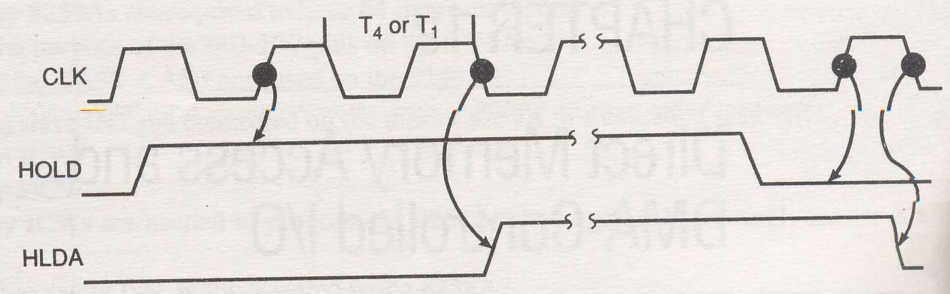
Timing for HOLD and HLDA
IF HOLD=logic-1, DMA action is requested. Microprocessor responds
to it by suspending its execution and placing its address, data and
control buses at high-impedence state. Then the I/O devices can
access the system buses.

Slide 4
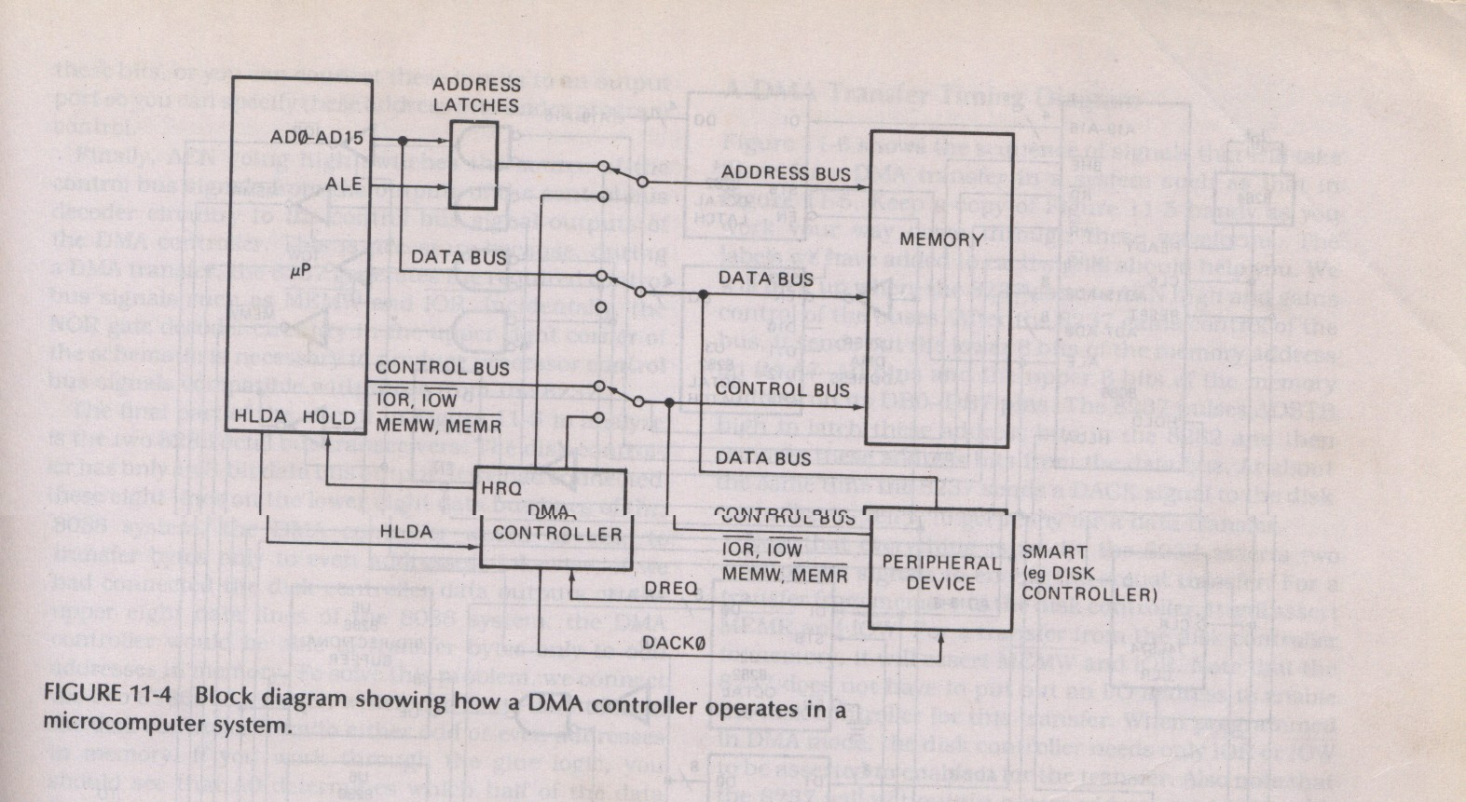
DMA Operation

Slide 5
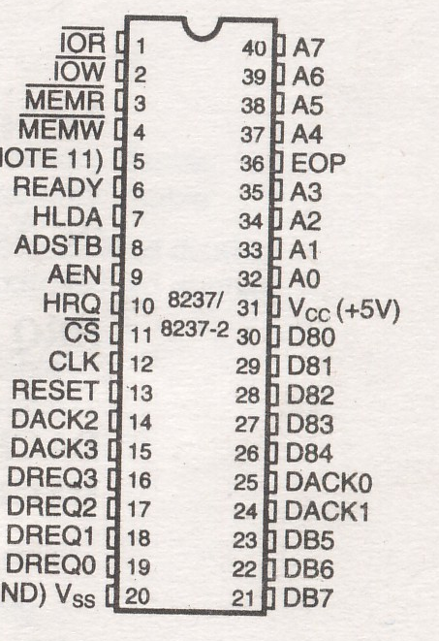
Pin Configuration of 8237
A0-A7: Address Pins
DB0-DB7: Data Pins
IOR: I/O Read Pin
IOW: I/O Write Pin
MEMR: Memory Read Pin
MEMW: Memory Write Pin
Ready: Ready Signal Pin
HLDA: Hold Acknowledge Pin
CS: Chip Select Pin
CLK: Clock Pin
RESET: Reset Circuit Pin
DACK0-DACK3: DMA Acknowledge Pins
DREQ0-DREQ3: DMA Request Pins
AEN: Address Enable Pin
ADSTB: Address Strobe Pin
HRQ: Hold Request Pin
EOP: End-of-Process Pin

Slide 6
Internal Registers of 8237
8237 has 9 internal registers for different purposes.
Most of the registers are 8-bit long and each bit has its special operation.
The registers are: CAR, CWCR, BA and BWC, CR, MR, BR, MRSR, MSR, SR.
As an example of typical 8237 internal register, let us notice the following bit pattern.
0 | 0 | 1 | 0 | 0 | 1 | 1 | 0

Slide 7
Registers’ Descriptions
CAR: CAR stands for Current Address Register. It is used to hold the 16 bit memory address used for DMA transfer.
CWCR: CWCR stands for Current Word Count Register. It holds the number of bytes to be transferred.
BA-BWC: Base Address and Base Word Count registers are used when auto initialization is selected for any channel. They reload CAR and CWCR after a DMA action is accomplished.
CR: Command Register programs the operation of 8237 DMA controller.
MR: Mode Register programs the mode of operation for a channel.
BR: Bus Request register is used to request a DMA transfer via software.

Slide 8
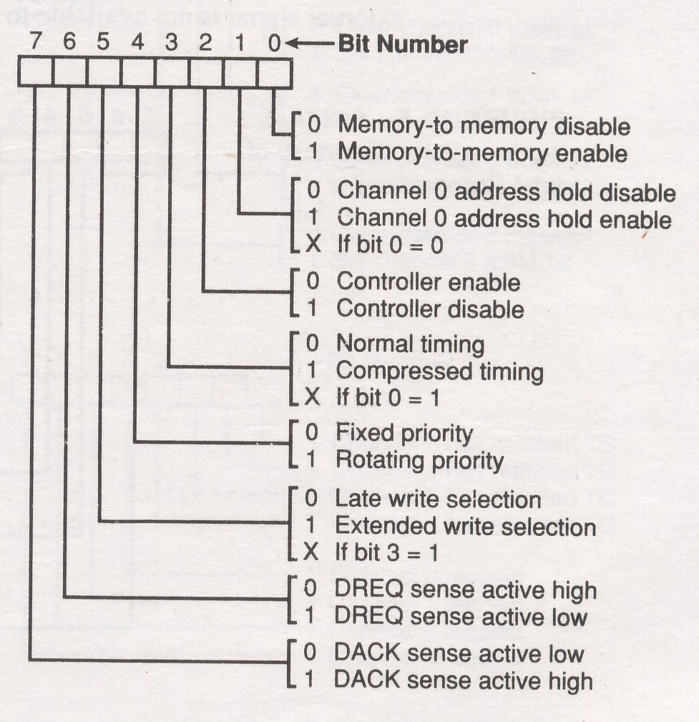
8237 Command Register

Slide 9
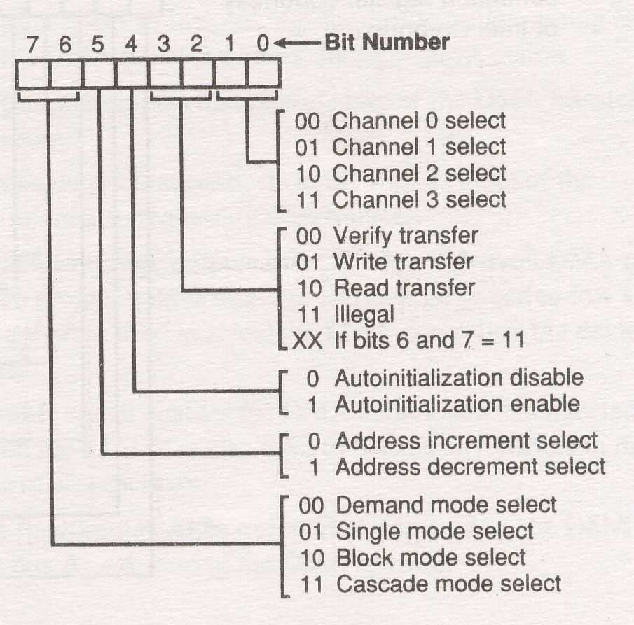
The Mode Register

Slide 10
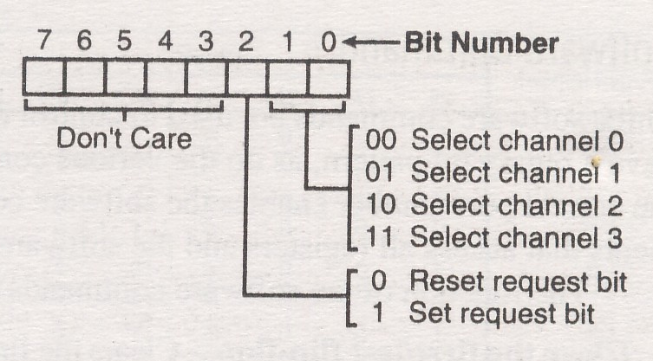
The Request Register

Slide 11
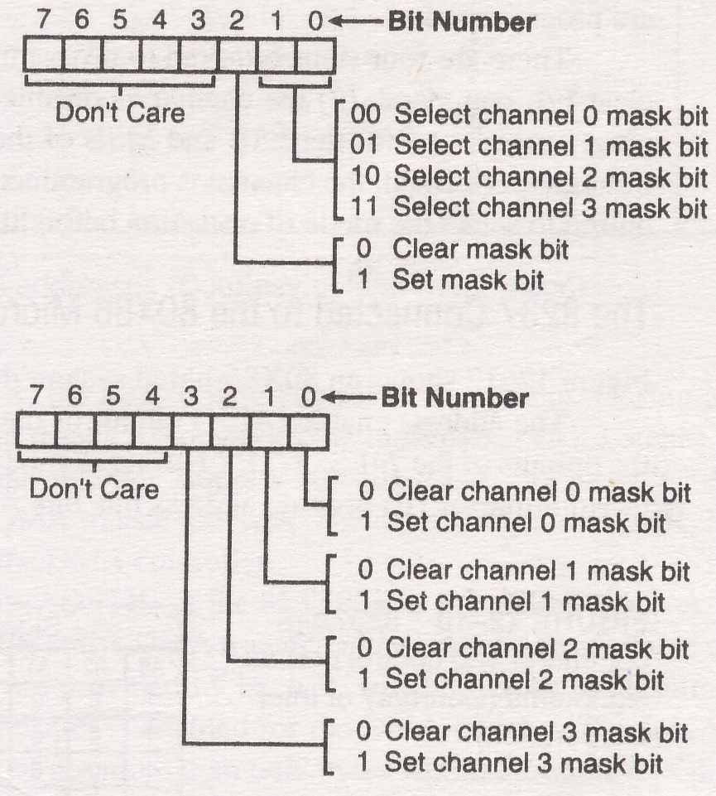
The Mask Register Set/Reset and the Mask Register

Slide 12
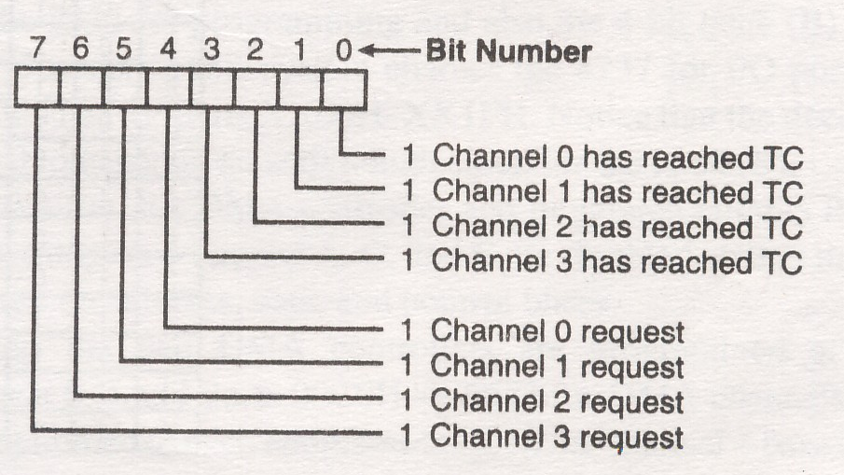
The Status Register

